Slide 1

Lesson 4:
Common Derivatives

Slide 2


Introduction

Slide 3

Lecture Overview:
Goals of the lecture:
Understand derivatives of some common functions

Slide 4
Derivatives of Common Functions

Slide 5


Polynomials
$$f\left(x\right)={ax}^{n}$$
$$f′\left(x\right)={anx}^{n−1}$$

Slide 6
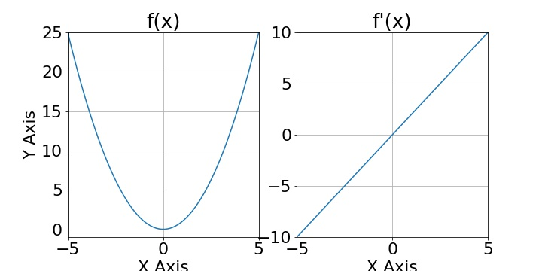

Polynomials
$$f\left(x\right)={ax}^{n}$$
$$f′\left(x\right)={anx}^{n−1}$$
$$f\left(x\right)=x^{2}$$

Slide 7

Polynomials
$$f\left(x\right)={ax}^{n}$$
$$f′\left(x\right)={anx}^{n−1}$$
$$f\left(x\right)=x^{2}$$
$$f^{′}(x)={2x}^{2−1}=2x$$

Slide 8
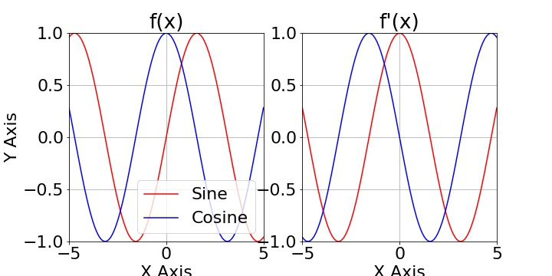




Trigonometric Functions
$$f\left(x\right)=sin⁡(x)$$
$$f′\left(x\right)=cos⁡(x)$$
$$f\left(x\right)=cos⁡(x)$$
$$f^{′}(x)=−sin⁡(x)$$

Slide 9
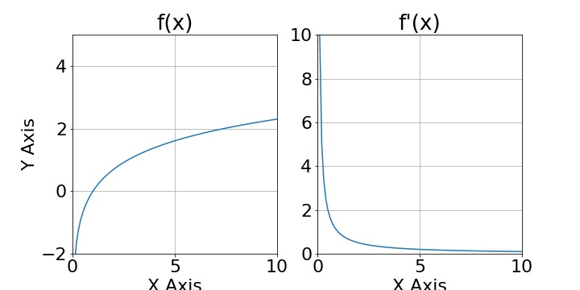
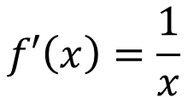

Logarithms Functions
$$f\left(x\right)=ln⁡(x)$$
$$f′\left(x\right)=\frac{1}{x}$$

Slide 10
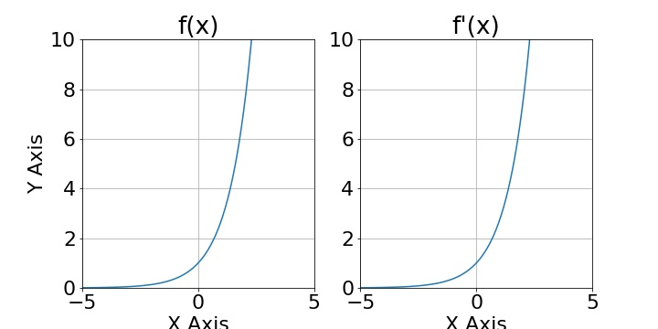


Exponential Functions
$$f\left(x\right)=e^{x}$$
$$f′\left(x\right)=e^{x}$$

Slide 11
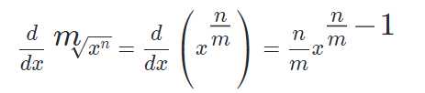

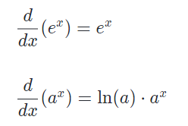
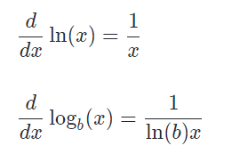
Common Derivatives (Cheat Sheet)
Polynomials
Radicals
Exponentials
Logarithms

Slide 12
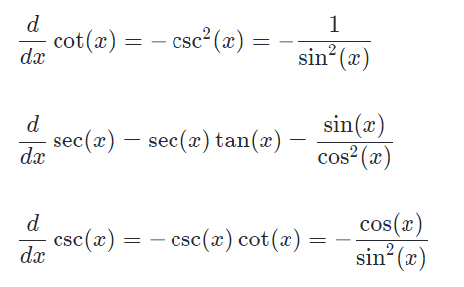
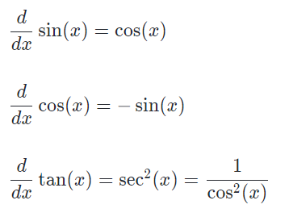
Common Derivatives (Cheat Sheet)
Trigonometric

Slide 13
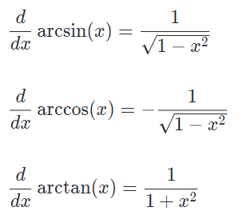
Common Derivatives (Cheat Sheet)
Inverse Trigonometric

Slide 14
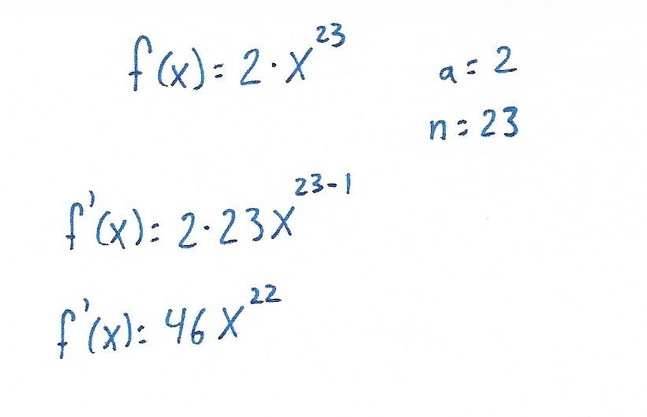
Problem 1:
Problem 1: Calculate f ’(x)

Slide 15
Problem 1:

Slide 16
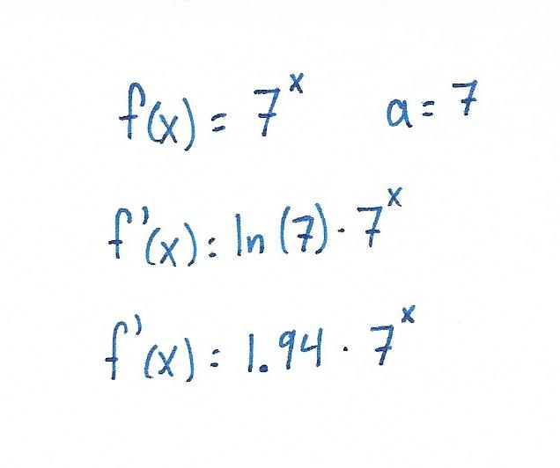
Problem 2:
Problem 2: Calculate f ’(x)

Slide 17

Problem 2:

Slide 18
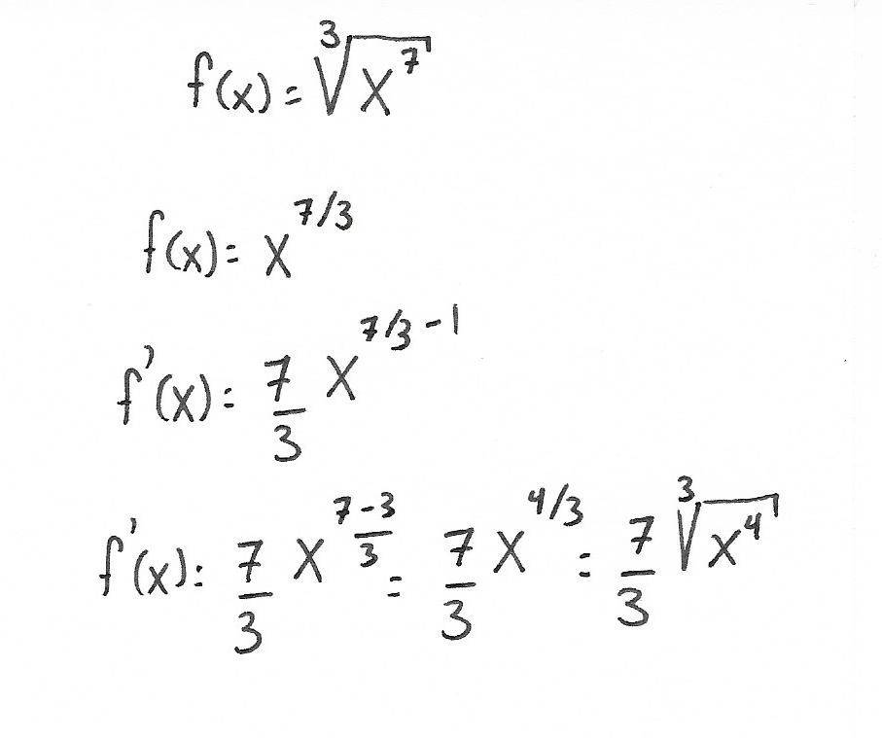
Problem 3:
Problem 3: Calculate f ’(x)

Slide 19

Exercise: Calculate the derivative

Slide 20
QUESTIONS?

